Slide 1

STUDENT INFORMATION MANAGEMENT SYSTEM
Valdez, Carl Xavier C.
Ramirez, Ian Cedric R.
Dela Cruz, Jedidiah Andrei V.
Aspiras, Carlo John C.
Calderon, Kathleen May M.
Gutierrez, Ara G.
Bachelor of Science in Computer Science

Slide 2
The STUDENT INFORMATION MANAGEMENT SYSTEM or SIMS is for Bachelor of Science in Computer Science Course of College of Computing Studies Information Communication and Technology of Isabela State University Echague Campus. This project focuses on the Gathering, Analyzing and Reviewing data for the target of the project to cater the different transactions of the Course. These transactions are comprising of gathering of student basic data, class info, schedule of classes, class designation, research and activities that are incorporate with.
INTRODUCTION

Slide 3
Bachelor of Science in Computer Science, Program Chair experience the following problems in the current system is it was a network-based system; No web-based system of higher year of the course; Difficult of accessing in real-time for quick change of schedule/s or changing of professor/s on a subject/s. Also, the SPS will act as newsfeed for changes for an accurate information to students whom have difficulty in contacting their professor/s. The College Secretary uses the network-based system for the repository of grades and unit or subject that a student has taken; for announcing schedules or change to their subject Messenger App is used; late announcement due to poor internet connections are one major problem she encounters.
INTRODUCTION

Slide 4
In order to solve the current problems of Bachelor of Science in Computer Science Course, the proponent will design and develop a Web-Based System Student Profiling System to monitor and inform students and professors in the College Course. Using the system, the data will be analyzed automatically by the system in a tabular format. The data are now organized and the records of the different rates are stored in the Database of the system.
INTRODUCTION

Slide 5
RAPID APPLICATION DEVELOPMENT Rapid Application Development (RAD) is a form of agile software development methodology that prioritizes rapid prototype releases and iterations. Unlike the Waterfall method, RAD emphasizes the use of software and user feedback over strict planning and requirements recording.
METHODOLOGY

Slide 6
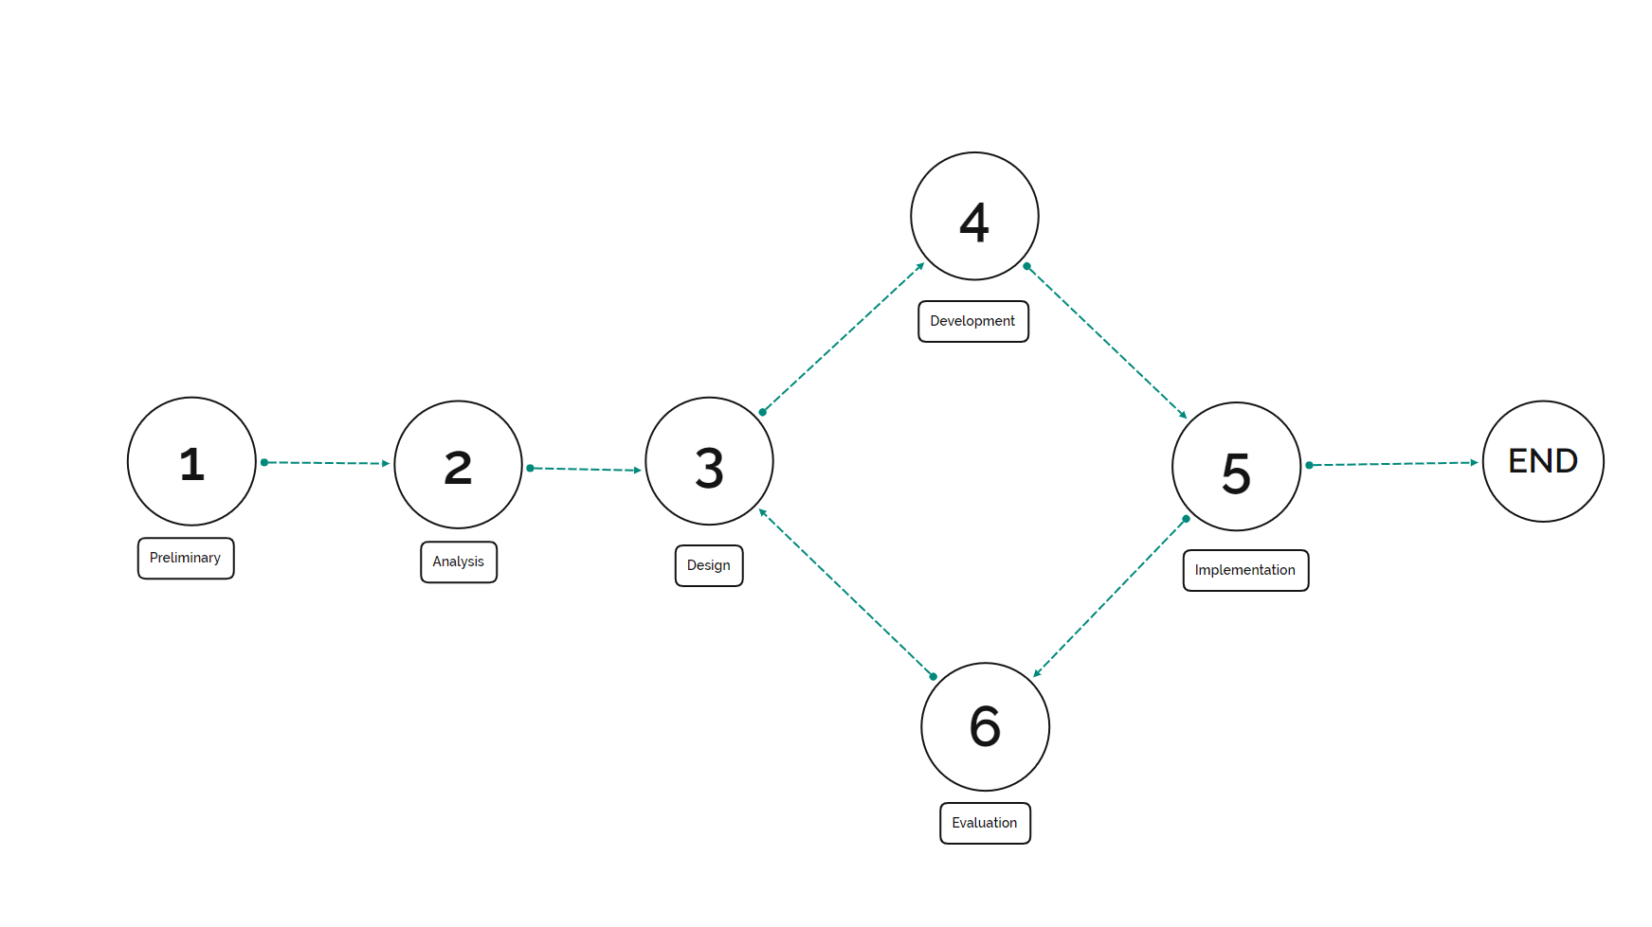
methodology

Slide 7
The Bachelor of Science in Computer Science is a four-year program that includes the study of computing concepts and theories, algorithmic foundations, and new developments in computing. The program prepares its students to design and create algorithmically complex software and develop new and effective algorithms for solving computing problems. A course offered by College of Computing Studies Information Communication and Technology in Isabela State University Echague Campus.
METHODOLOGY

Slide 8
RESULTS

Slide 9
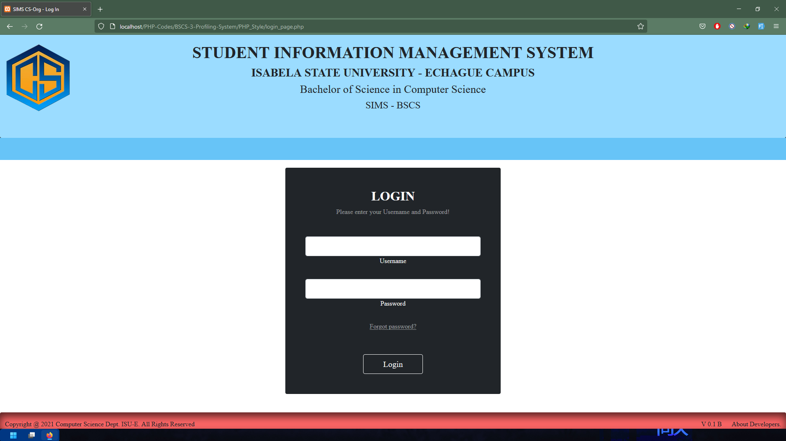
Login Form contains requires username and password.
RESULTS
RESULTS

Slide 10
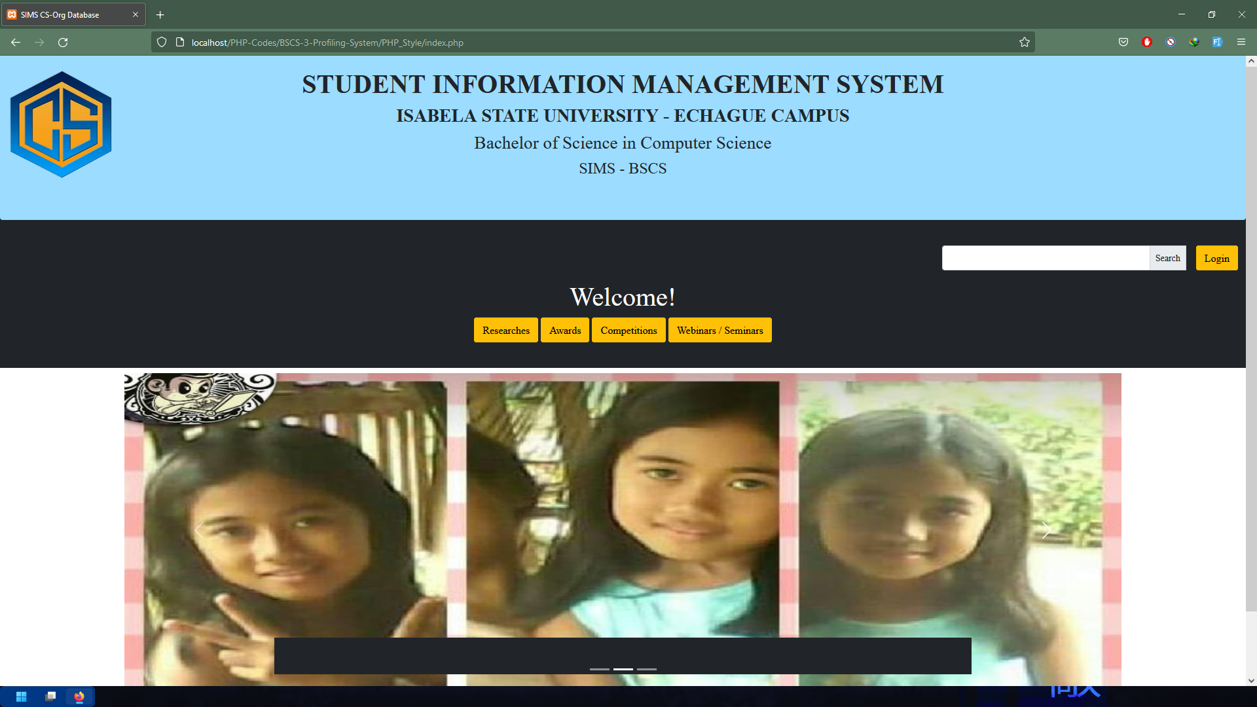
Home Page contains mission, vision, and objectives of Bachelor of Science in Computer Science

Slide 11
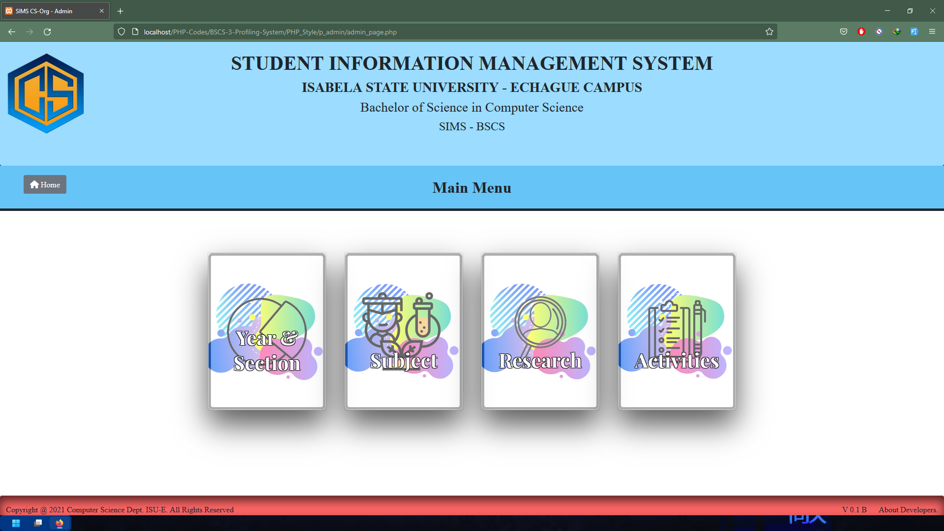
Main Menu contains the four main menu which is Year & Section, Subject, Research, and Activities

Slide 12
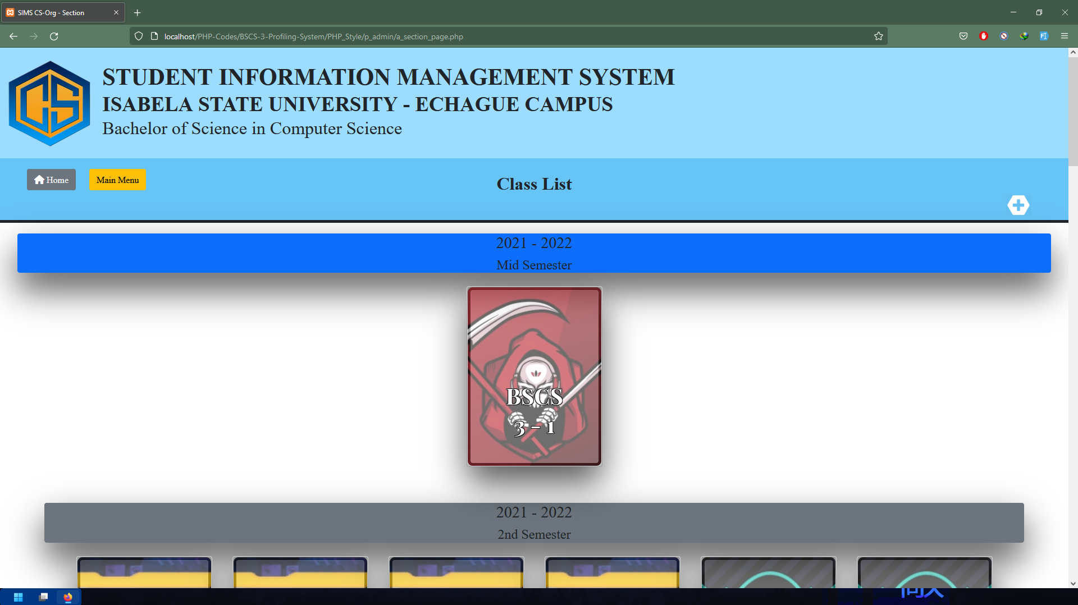
Class List Page contains new and old classes.

Slide 13
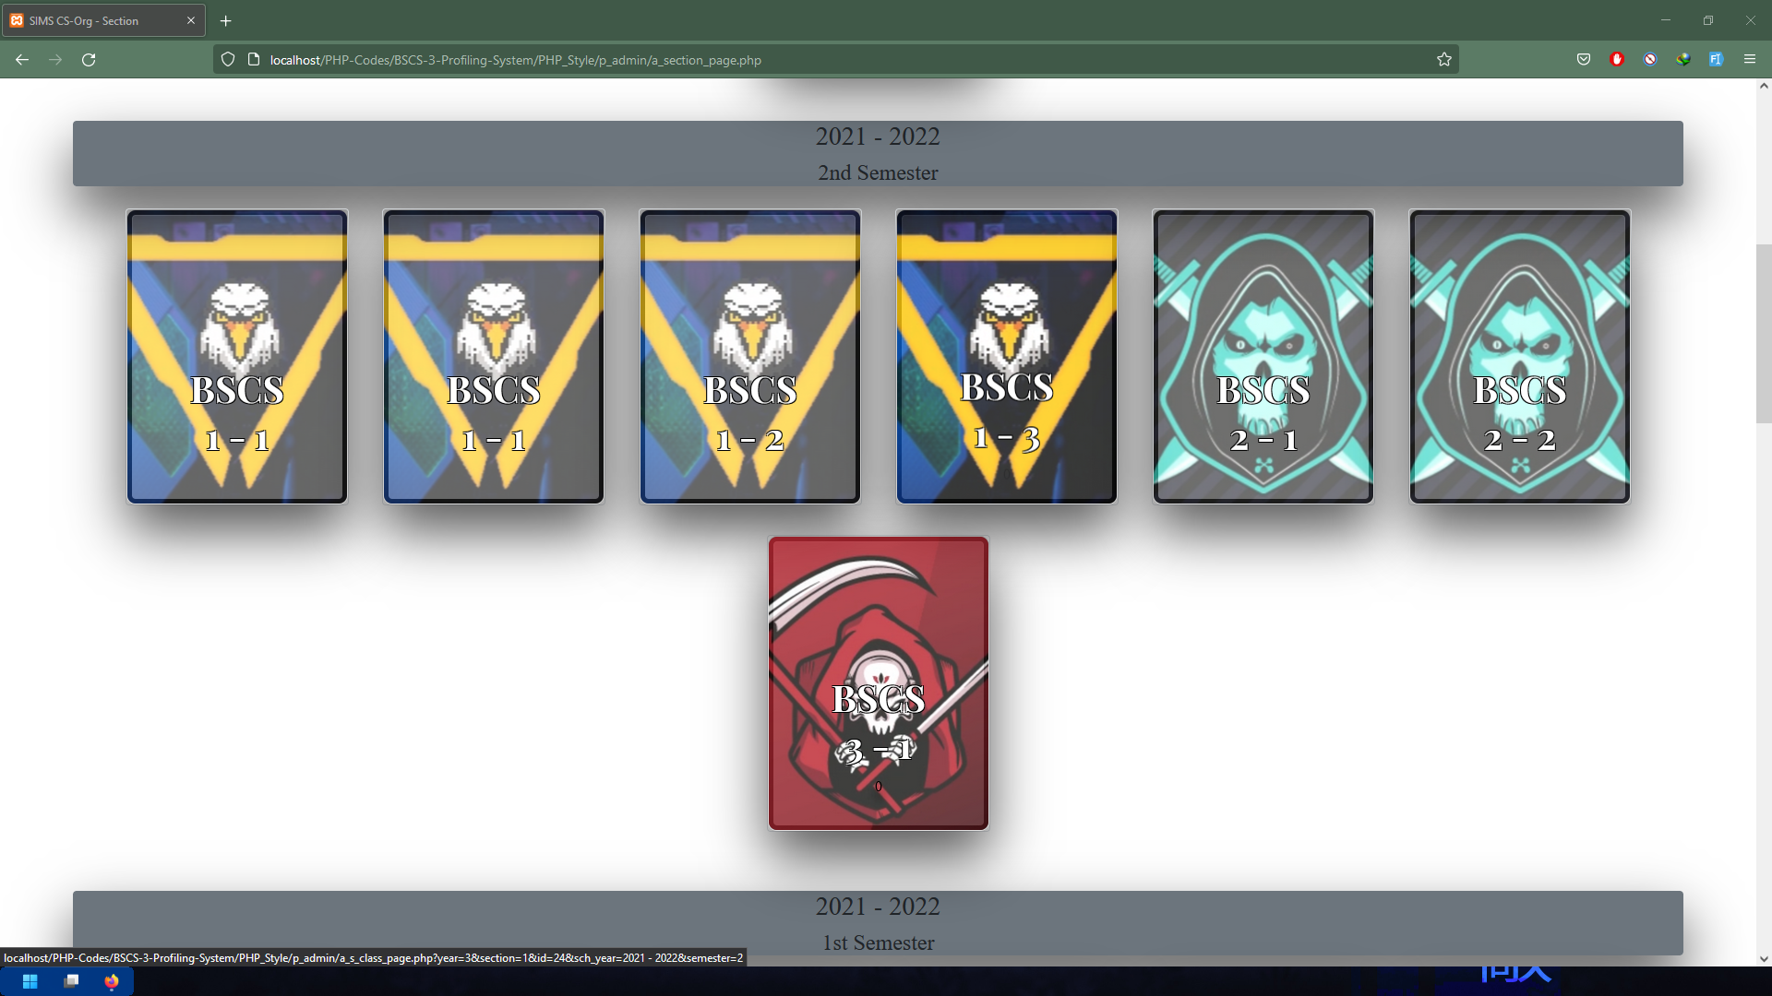

Slide 14
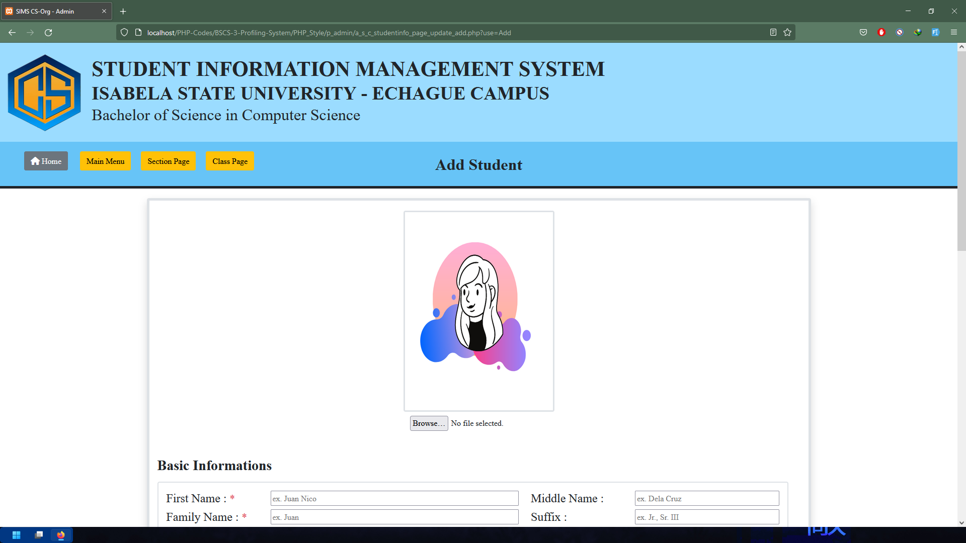
Add Student Form contains gathered basic information of students. Also add student display picture.

Slide 15
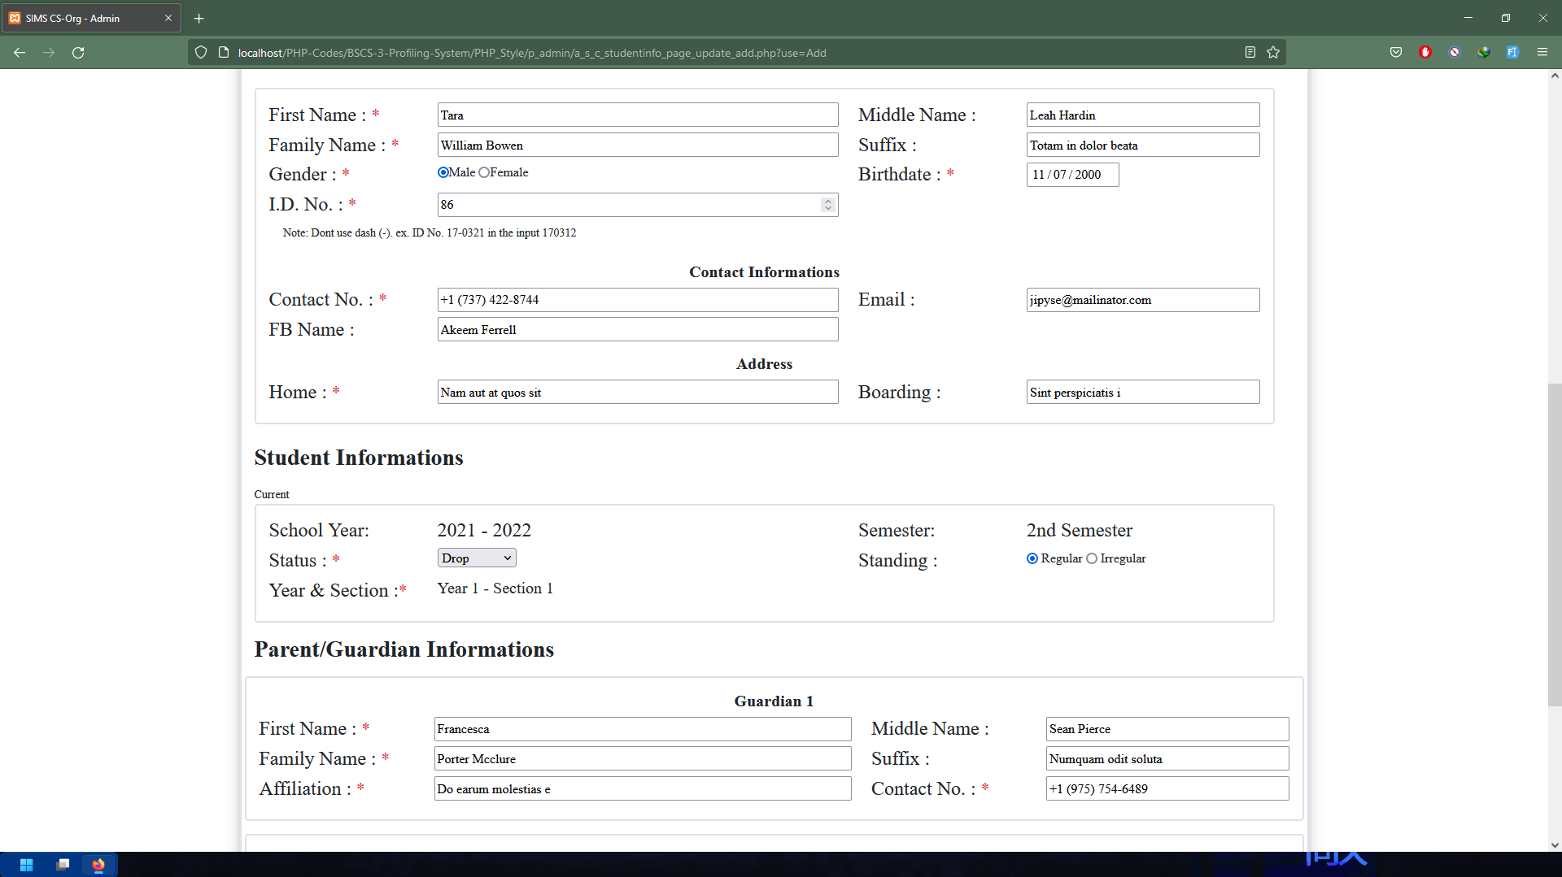

Slide 16
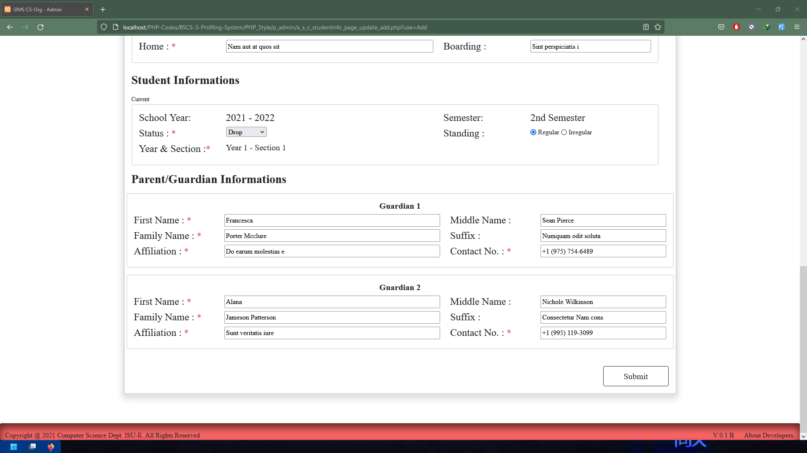

Slide 17
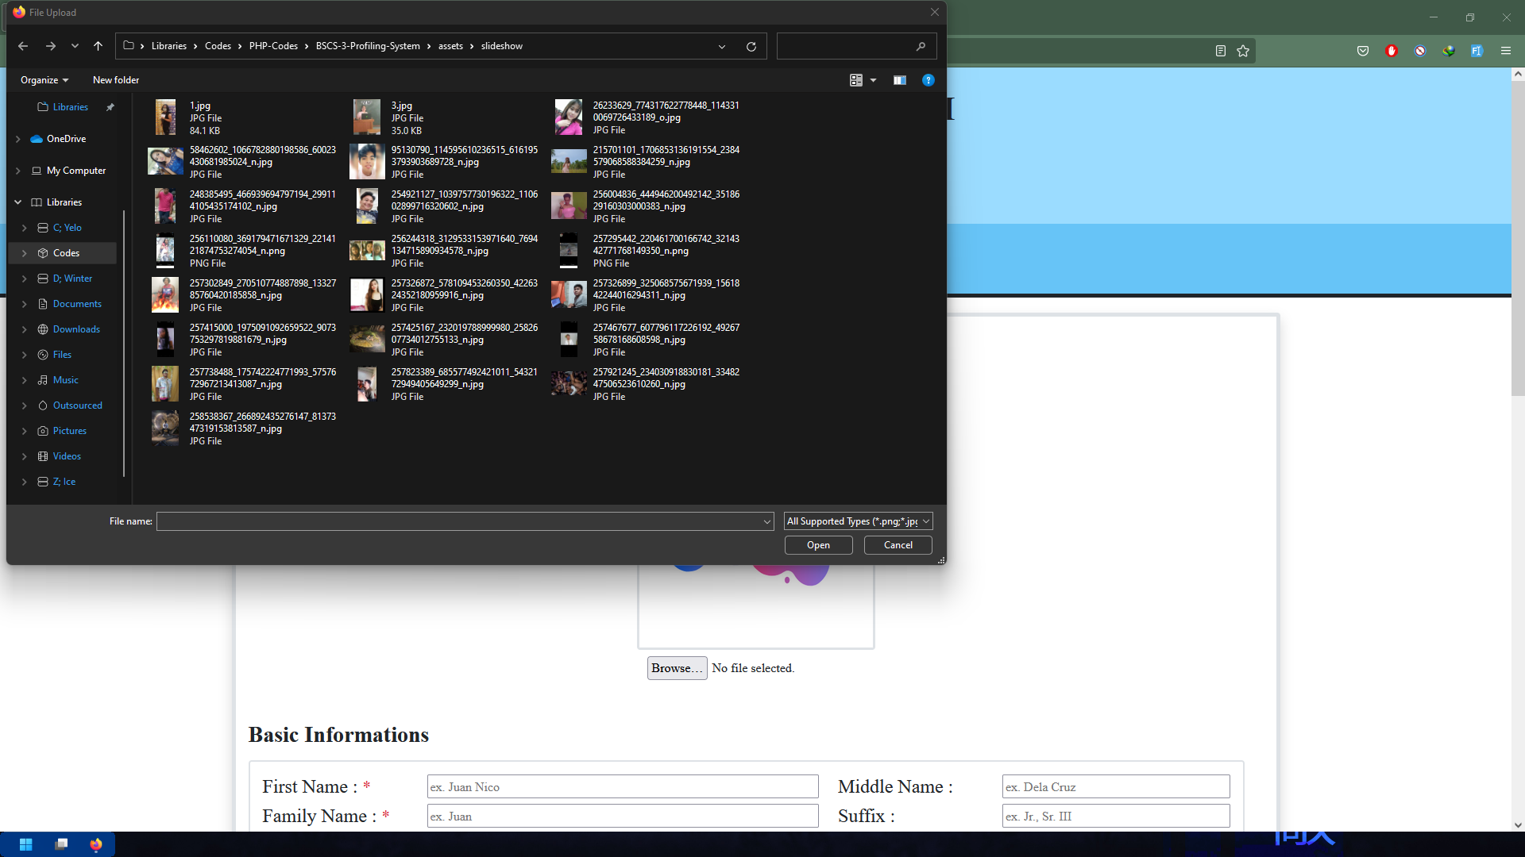

Slide 18
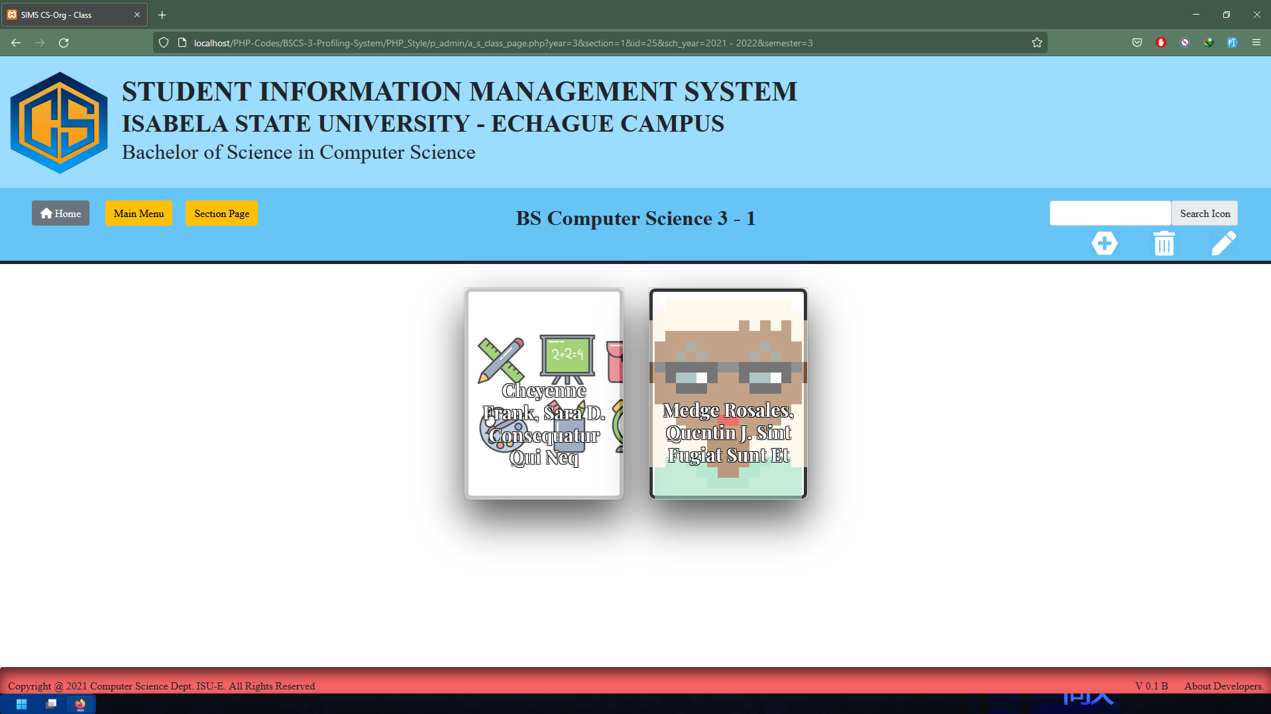
Class Page contains enrolled students.

Slide 19
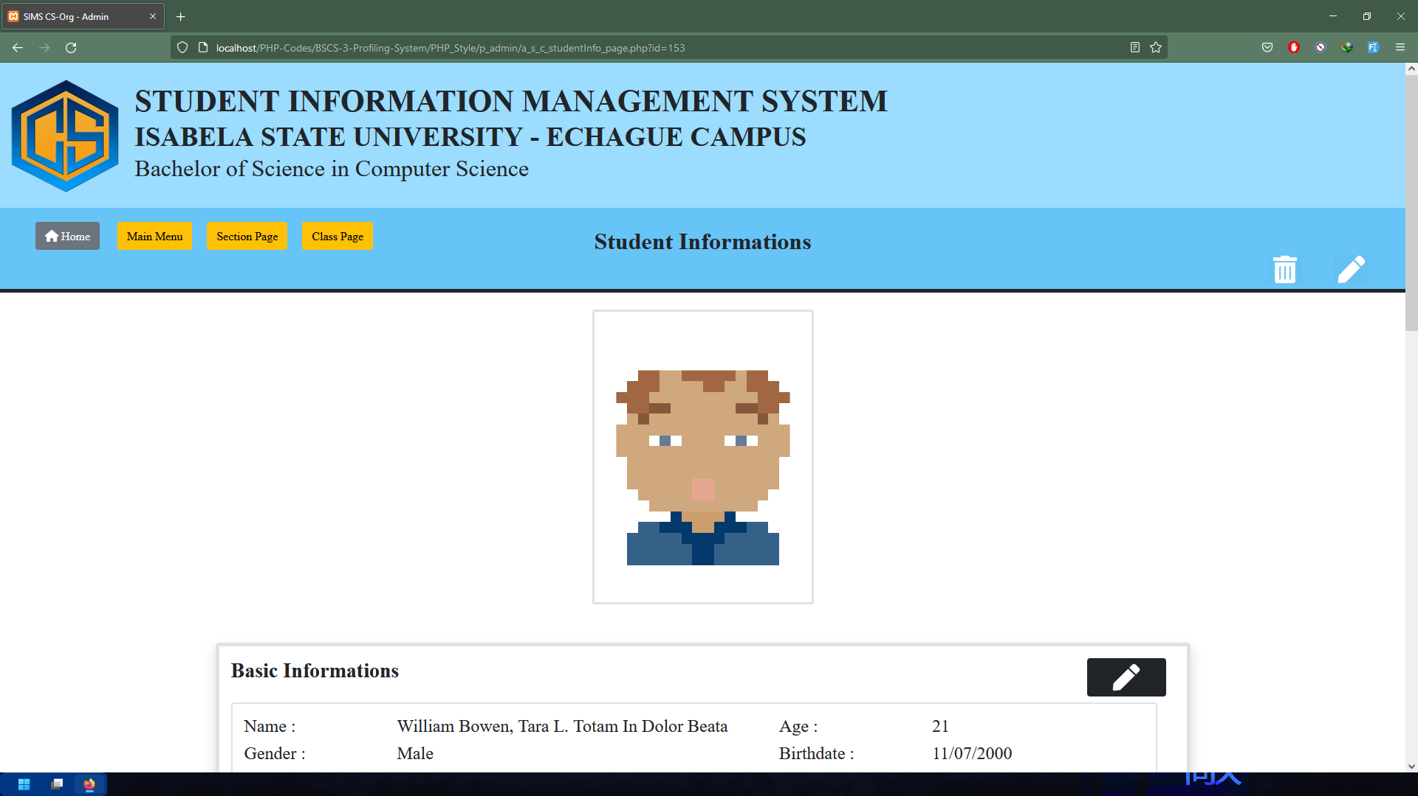
Student Information Page contains the basic information, subject enrolled, research/es (if any), awards receive, competitions participated, and seminar attended.

Slide 20
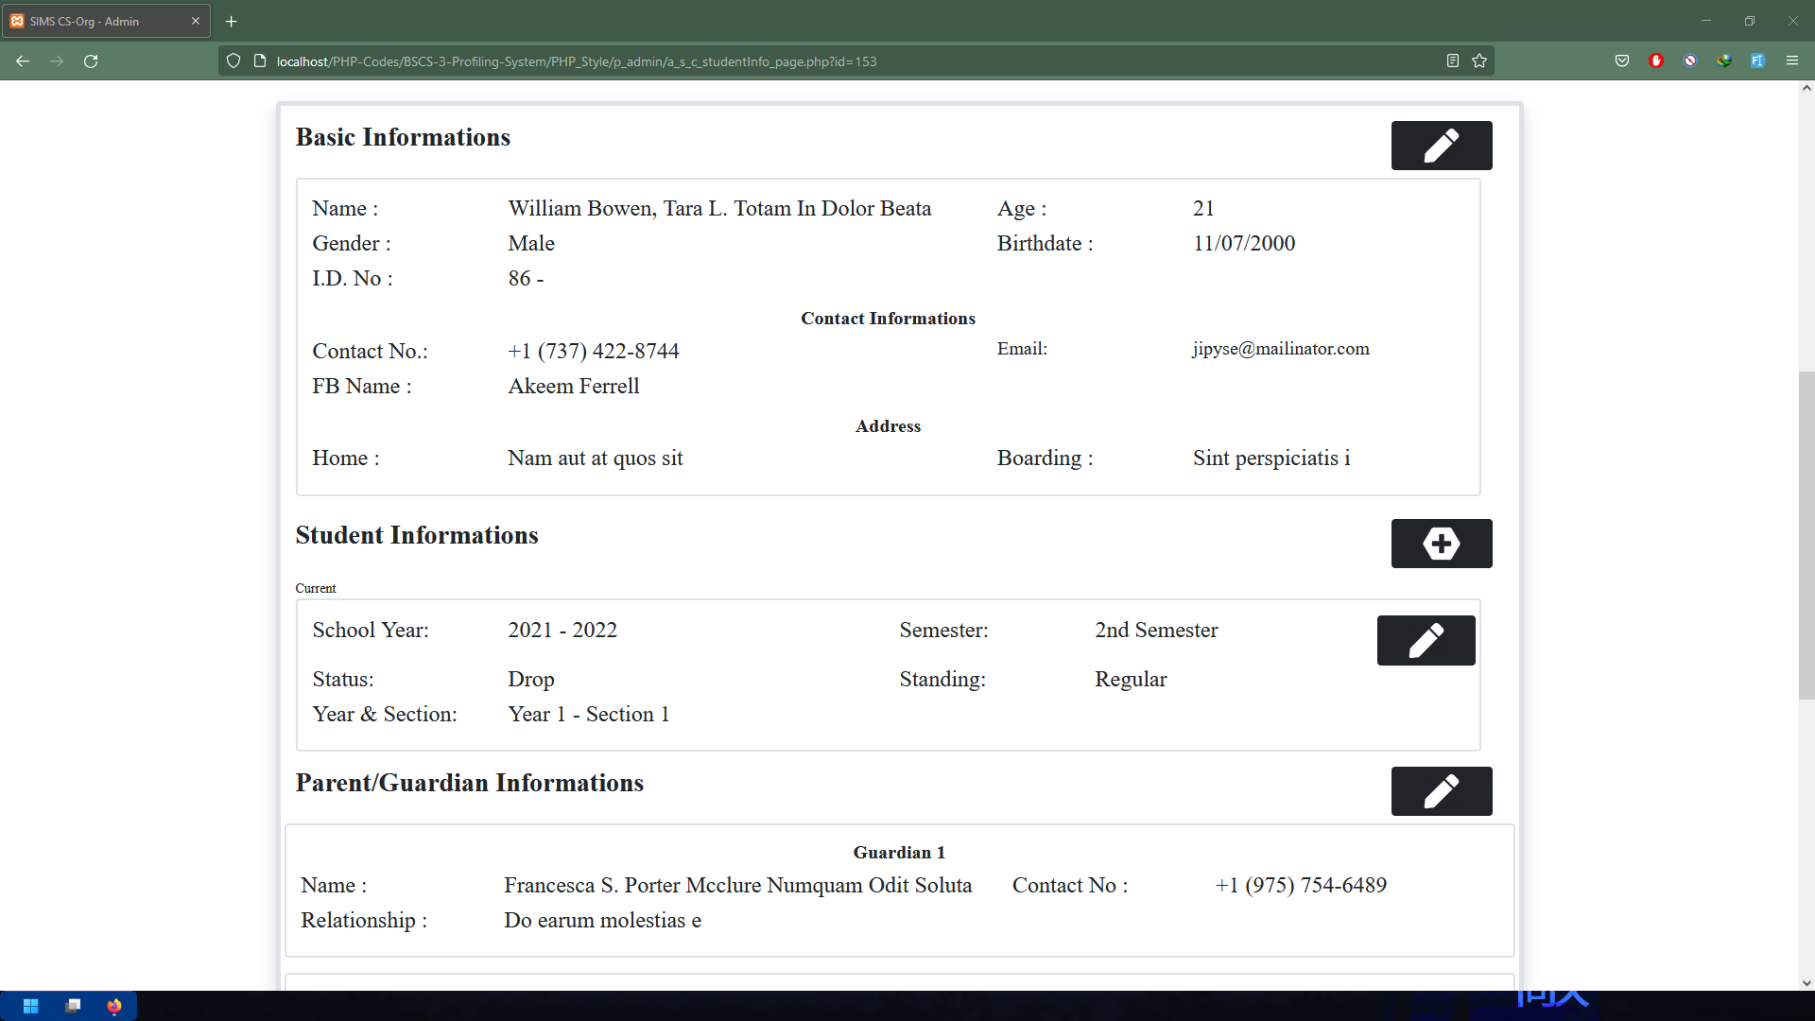

Slide 21
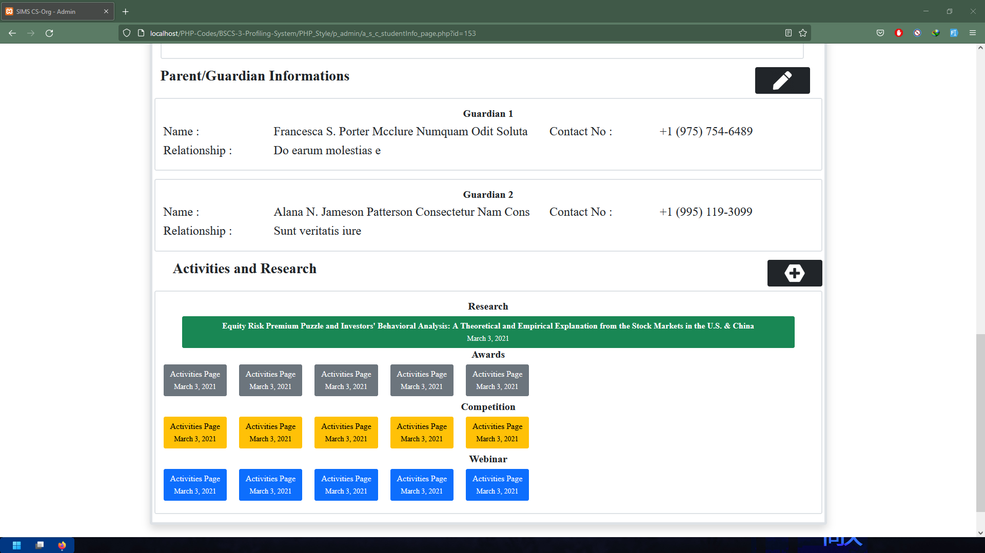

Slide 22
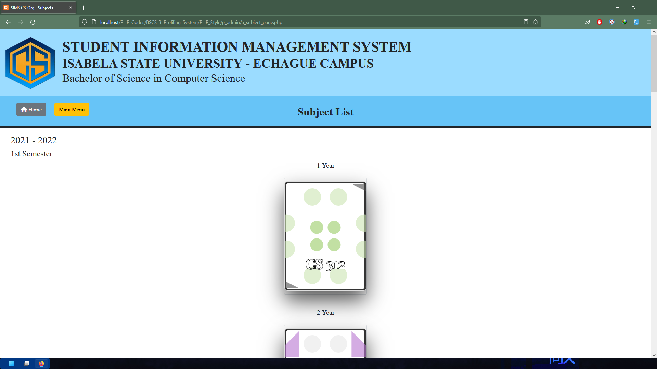
Subject List Page contains all offered units per semester and academic year in the curricula.

Slide 23
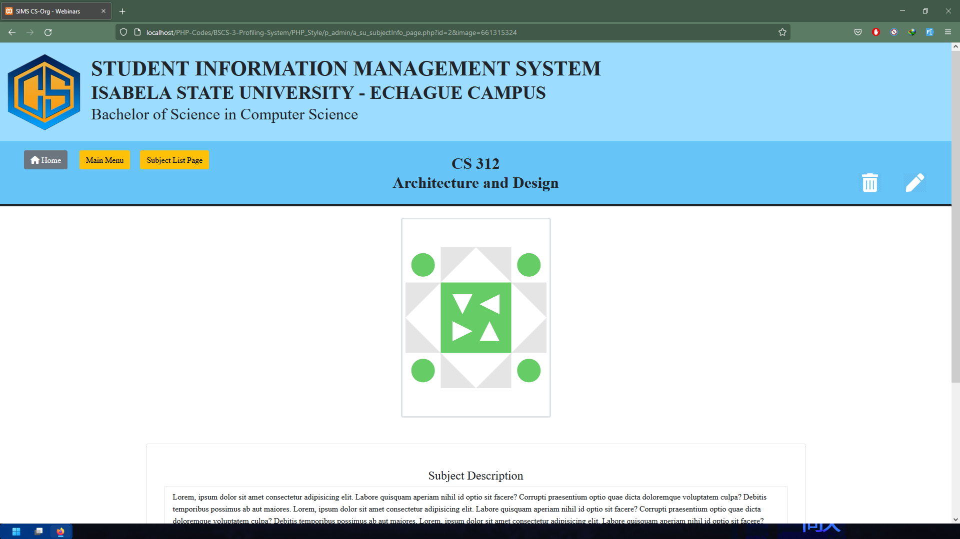
Subject Page contains subject description and related information's about the subject.

Slide 24
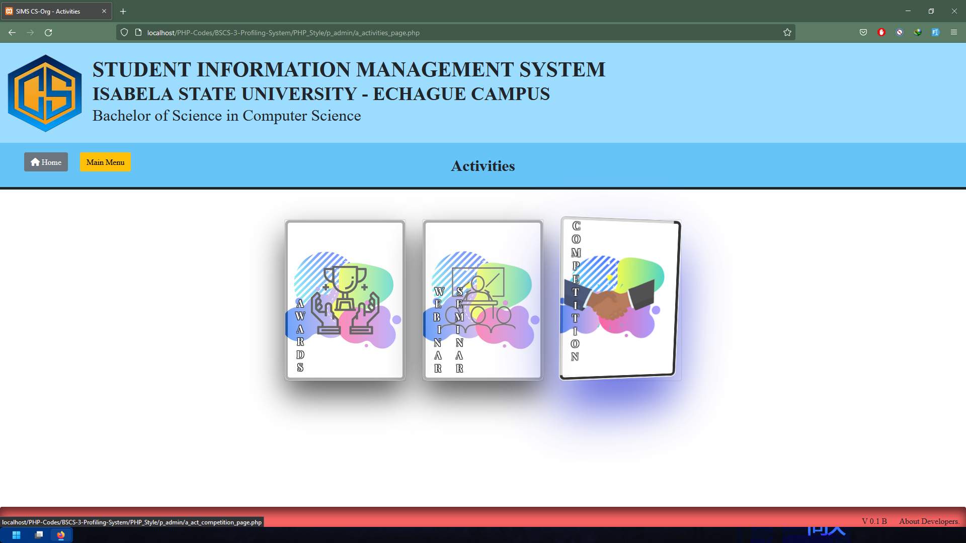
Activities Menu Page contains Award, Seminar and Competition. This includes the activities participated by the students.

Slide 25
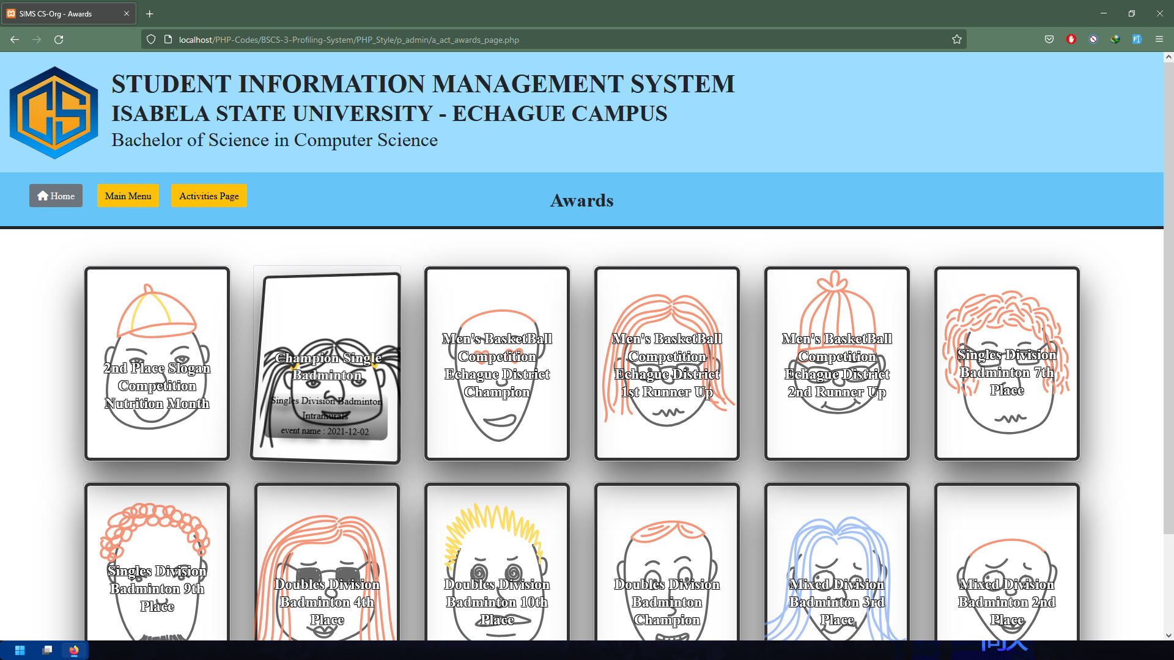
Awards List Page contains all awards receive by students of the course.

Slide 26
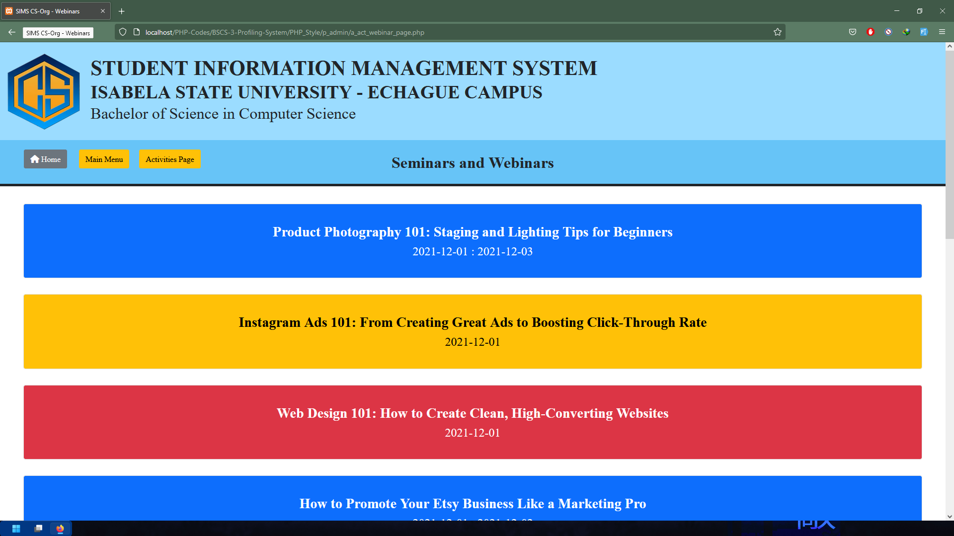
Seminars and Webinars Page contains all seminars and webinars attended by students of the course.

Slide 27
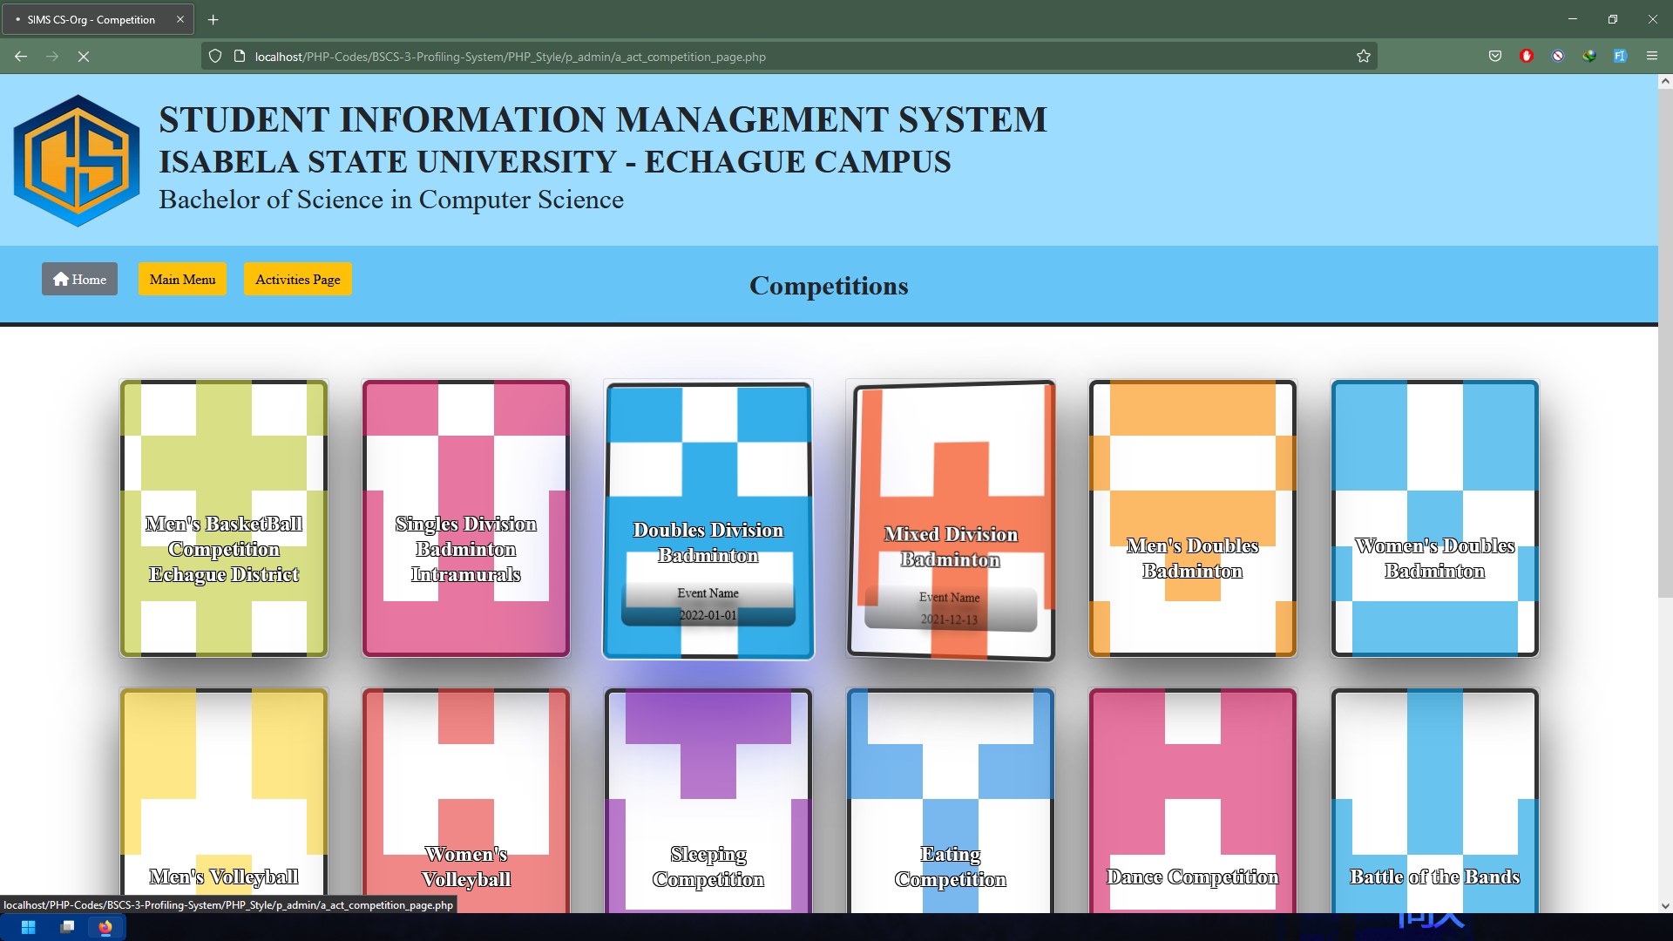
Competition List Page contains all Competitions participated by the students of the course.

Slide 28
Visual Studio Code- is a streamlined code editor with support for development operations like debugging, task running, and version control. Use it to code in any programming language, without switching editors. Visual Studio Code has support for many languages, including Python, Java, C++, JavaScript, and more. It aims to provide just the tools a developer for a quick-build-debug cycle and leave more complex workflows fuller featured IDEs, such as Visual Studio IDE. MySQL – is free and open source software under the terms of the GNU (General Public License, and is also available under a variety of propriety licenses. MySQL was owned and sponsored by the Swedish company MySQL AB, which was bought by Sun Microsystem (now Oracle Corporation). In 2010, when Oracle acquired Sun, Widenius forked the open-source MySQL Project to create MariaDB.
RESULTS

Slide 29
Adobe XD – is a powerful and easy-to-use vector-based experience design platform that gives teams the tools they need to craft the world’s best experiences collaboratively. Adobe XD helps to craft prototypes that look and feel like the real thing, so you can communicate your design vision and maintain alignment across your team efficiently. Adobe Photoshop- is software that is extremely used for raster image editing, graphic design and digital art. It makes use of layering to allow for depth and flexibility in the design and editing process, as well as provide powerful editing tools, that when combined, are capable of just about anything.
RESULTS

Slide 30
Adobe Illustrator- is the industry standard design app that lets you capture your creative vision with shapes, color, effects, and topography. It is used to create a variety of digital and printed images, including cartoons, charts, diagrams, graphs, logos, and illustrations. Illustrator allows a user to import a photograph and use it as a guide to trace an object in the photograph. Gitkraken- it is a powerful and elegant multiplatform graphical interface for Git developed by Axosoft, as an alternative to command line. In a simple way, we can keep a complete track of our repositories, see branches, tags, and create new, all the history of our work, commits and so on. XAMPP- is an abbreviation for cross-platform, Apache, MySQL, PHP and Perl, and it allows you to build WordPress site offline, on a local web server on your computer. This simple and lightweight solution works on Windows, Linux, and Mac- hence the “cross-platform’ part.
RESULTS

Slide 31
The system will have two types of users, the first user is the administrator which is the Program Chair followed by the class president. The system is capable to Manage Students’ Records such as the following, the first is the student manage profile in which the system is capable to collect the basic information of the student’s including the name, address, contacts and scholarship grant. It also includes the subjects enrolled for every student and professor involved. Next the system is capable to Manage Student Activities wherein the system is capable to track the different contested activities, who are the following students are willing to join and update the award that given to the students. It also includes the update of the different webinars that related to the course.
DISCUSSION

Slide 32
And under the Manage Student Research Repository, the system is capable to store and retrieve student researches base by the titles and the abstracts. Another set of users of the system is the (Representative) account where in the user is capable to manage student information of their section. Wherein the class president/vice-president can update student’s information, update student’s activities. The System will be designed using Adobe XD as the interface prototyping of the user to the system. The System will be developed using HTML, PHP, JavaScript and CSS. The database of the system is MySQL server as the repository of data. It is a web-based system that will used two layer of architecture application layer and data layer. The System is a web-based system. It means that is accessible using a Web browser and is therefore accessible from anywhere in the world via the Web using any device.
DISCUSSION

Slide 33
Thank you for listening

